Slide 1
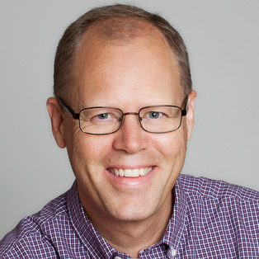
Graph Databases Many relations in an easier way
Jakob Lithner Squeed, Göteborg
Notes:
Jag har jobbat som utvecklare i mer än 20 år. Jag sitter nu på Squeed som är ett konsultföretag i Göteborg och Stockholm.
I många team jag suttit med i, så finns det utvecklare som säger ungefär så här:
“Det där med databaser är inte så noga. Det kan väl någon annan göra. Jag vill helst jobba med riktig kod.”
Jag menar att valet av databas är oerhört viktigt.
Hur man lagrar sin data, vilken storagetyp man väljer och hur man designar sin datamodell, det får ofta stora konsekvenser för hela din applikation!
Valet av storage påverkar prestanda, stabilitet och flexibilitet.
Gör man ett felaktigt val så kan det låsa in dig rätt mycket.
Det går inte att kompensera med ”bra kod”.

Slide 2

Which is the most powerful database in the world?
Notes:
Vilken är den bästa databas som finns?
Jag skulle säga att det är den mänskliga hjärnan!
Vad är det som gör den så speciell?
Det som framförallt gör hjärnan unik är inte storleken.
Which is the most powerful ”database” in the world?
The human brain!
What makes the human brain so extraordinary?
https://www.youtube.com/watch?v=lb90EBfAj0o

Slide 3
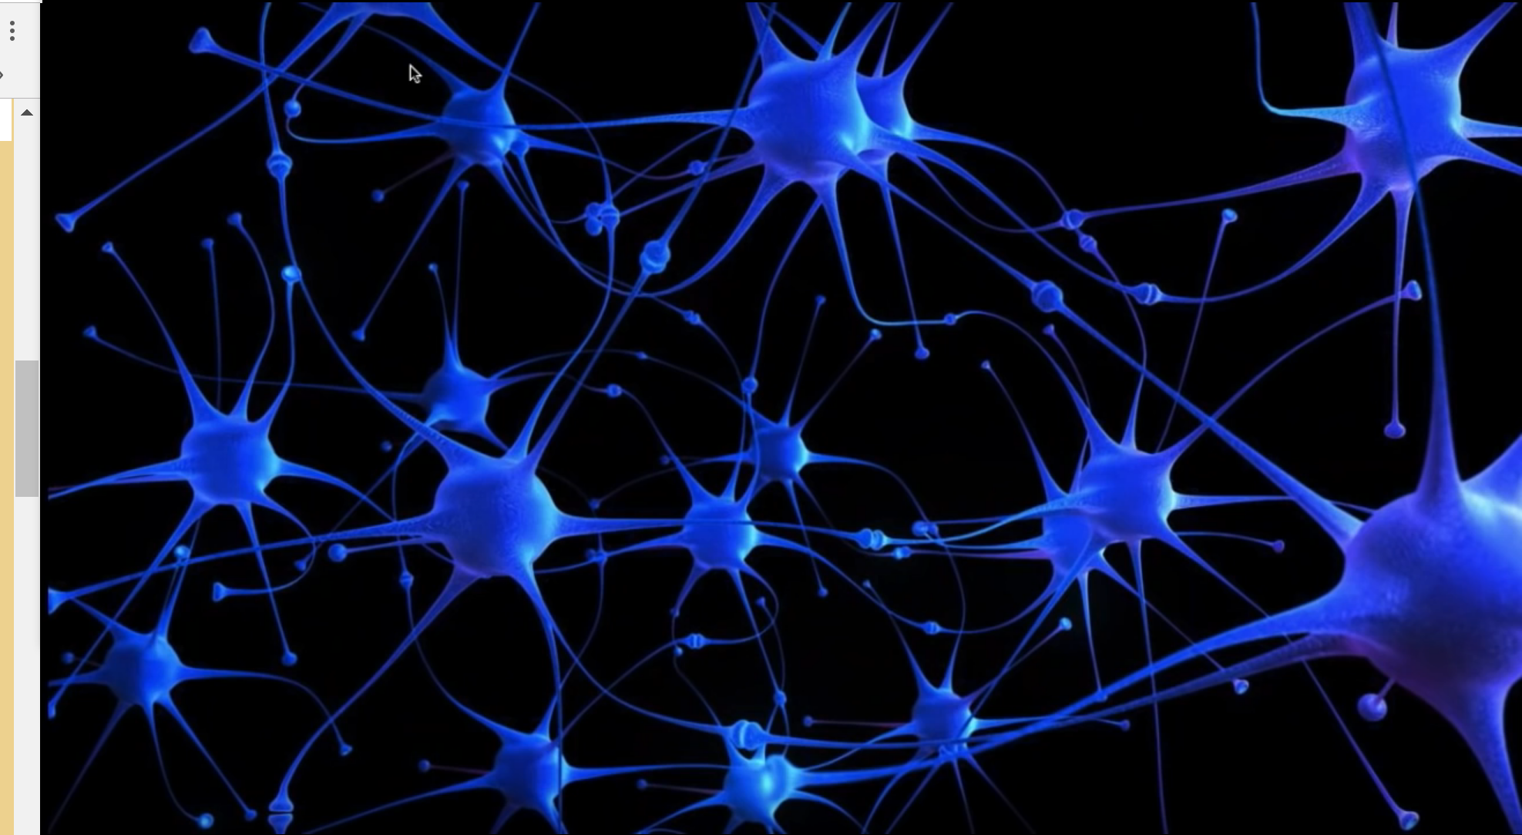
Notes:
Det mest spännande är inte hjärncellerna i sig utan synapserna, kopplingen mellan hjärncellerna.
Det är de många kopplingarna som gör det möjligt att associera och tänka kreativt.
Vi kan snabbt koppla samman data som är mycket olika och dra nya spännande slutsatser.
Det är precis det som grafdatabaser tar fasta på!
“Graf” har alltså inget med bilder att göra, utan det handlar om att bokstavligt allt kan ha relationer till allt på ett helt flexibelt sätt.

Slide 4
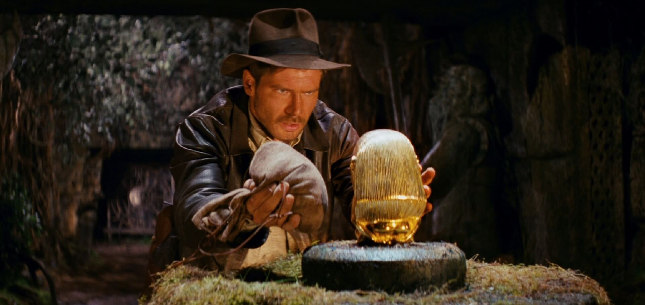
Graph Database
The hidden jewel in the NoSQL djungle
Your next adventure!
Notes:
Det jag tänkte göra är att ge en kort introduktion till grafdatabaser:
Varför man vill ha dem
Vilka varianter som finns
Hur man använder dem
När de passar att använda
Jag kommer att lägga betoningen på att förstå koncepten.
För er som vill ta ett steg vidare så har jag skapat ett repo på Github med ganska komplett kod.
Mitt argument är att grafdatabaser är något som många skulle kunna ha stor nytta av.

Slide 5
Why

Slide 6
Database types
SQL
Relational databases
Dictionary databases
Column databases
Document databases
Graph databases
NoSQL
Notes:
Sedan slutet av 1960-talet har den dominerande databastypen varit relationsdatabaser.
I början av 2000-talet började det växa fram en mängd alternativ som fick samlingsnamnet ”NoSQL”.
Som ni säkert vet så har det varit mycket diskussioner om vilken databas som är den bästa.

Slide 7
Database types
Relational databases
Dictionary databases
Column databases
Document databases
Graph databases
Records/Tables
Key-Value
Key-Column
Key-Document
Relations

Slide 8
Database types
”Relational” databases
Dictionary databases
Column databases
Document databases
Graph databases
Records/Tables
Key-Value
Key-Column
Key-Document
Relations

Slide 9
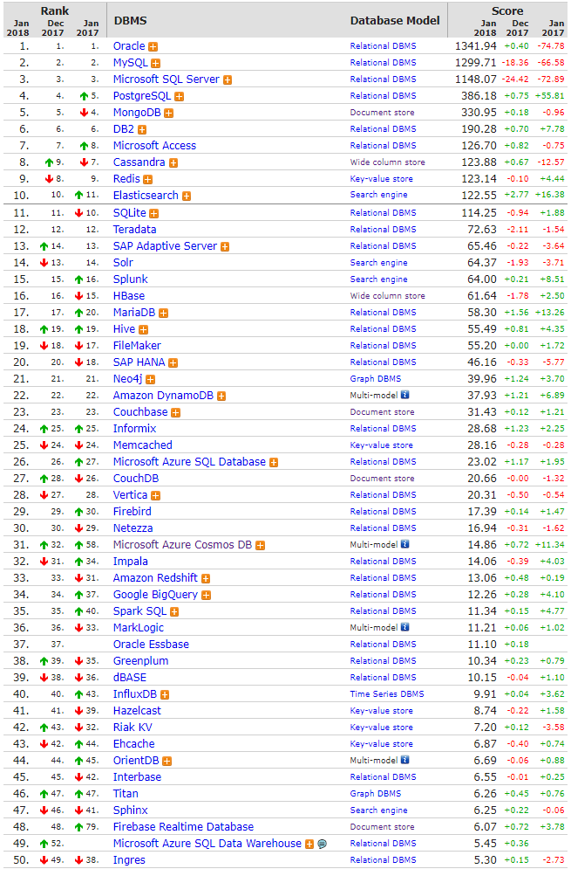
Database ranking
https://db-engines.com/en/ranking

Slide 10
Database types
Relational databases (Oracle, MySQL, SQL Server, PostgreSQL)
Dictionary databases (Redis, Amazon DynamoDB, Memcached)
Column databases (Cassandra, HBase)
Document databases (MongoDB)
Graph databases (Neo4j)
Notes:
https://db-engines.com/en/ranking
MongoDB: 79% in Document databases (66% if Multi model databases are included in comparison)
Neo4j: 81% Graph databases (50% if Multi model databases are included in comparison)

Slide 11
Database types
Relational databases (Oracle, MySQL, SQL Server, PostgreSQL)
Dictionary databases (Redis, Amazon DynamoDB, Memcached)
Column databases (Cassandra, HBase)
Document databases (MongoDB)
Graph databases (Neo4j)
Notes:
https://db-engines.com/en/ranking
MongoDB: 79% in Document databases (66% if Multi model databases are included in comparison)
Neo4j: 81% Graph databases (50% if Multi model databases are included in comparison)

Slide 12
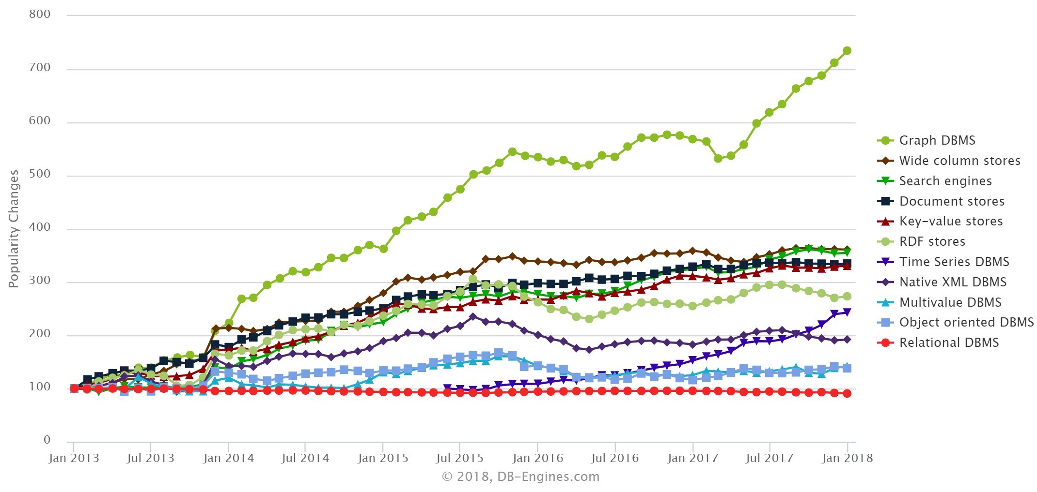
Popularity trends
Notes:
https://db-engines.com/en/ranking_categories

Slide 13
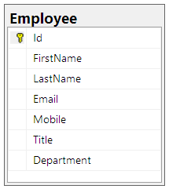
”Everything can be modeled in SQL”
Notes:
Har man jobbat länge med relationsdatabaser så vet man att man kan lösa det mesta.
Om jag bara klurar litet så kommer jag snart på en data modell som passar behoven.
Men det är lätt att måla in sig i ett hörn …
Change Request:
Every Employee should be related to a Manager

Slide 14
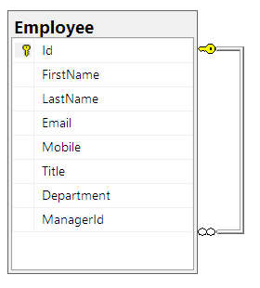
Employee Usecase
Notes:
Change Request:
Every Employee need to be related to several ”Managers” with different roles (Line Manager, Project Leader, Team Leader, Product Owner, Scrum Master, …)

Slide 15
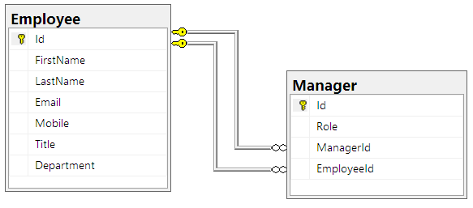
Employee Usecase
Notes:
Change Request: We have detected that some employees have private relations(!), we need to track that (for security reasons)

Slide 16
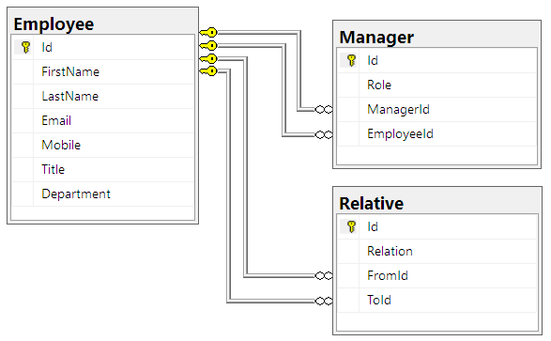
Employee Usecase
Notes:
Change Request: Users are also related through competence belonging
Departments need to be tracked because they are related in a tree

Slide 17
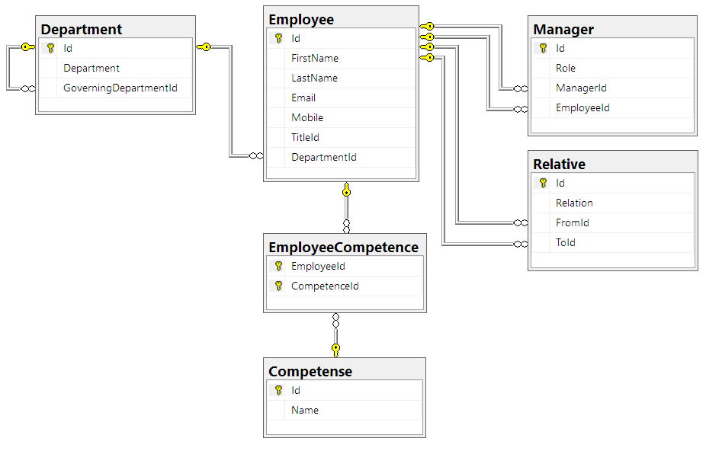
Employee Usecase
Notes:
It will continue to grow! Change requests will never end.
Every time you need to create a new database schema, plan a downtime for deploy, transform data.
Every time you need interesting data you will end up with complex queries.

Slide 18
Employee Usecase
List all employees that have a relative as direct manager
List all Employees in 3:rd level
I need a specific competence, what is the shortest way in my relational network to a person with that competence?

Slide 19
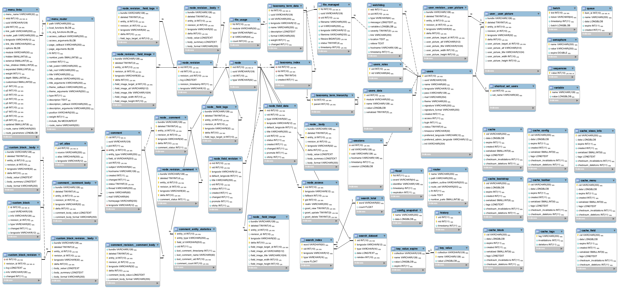
Challenges
Notes:
Database schema taken from Drupal CMS

Slide 20
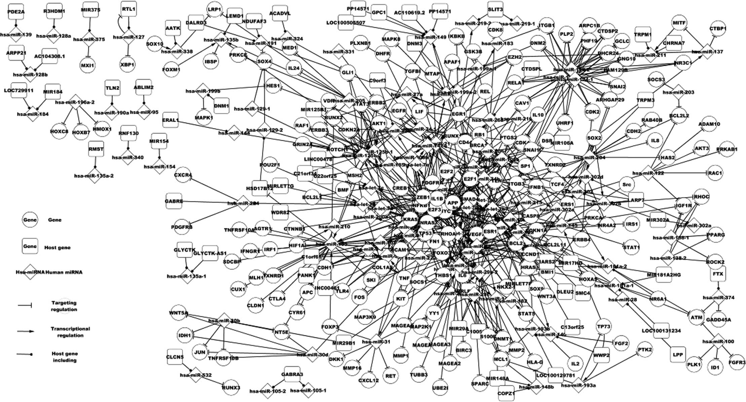
Challenges
Many relations
Static data models
Growing data
Agile workflow
Notes:
Genes detected in a cancer form
https://www.spandidos-publications.com/br/1/6/918

Slide 21
What

Slide 22
Neo4j - History
2000 Developed in Lund: Property graph model
2002 First working version
2004 First version in 24/7 production
2007 First graph db with native storage/processing
2007 Open Source
2009 Officially added to NoSQL family
2011 Cypher graph query language (declarative)
2016 Bolt protocol
2017 Multi-data center support
Notes:
https://neo4j.com/company/
https://neo4j.com/awards/
https://neo4j.com/staff/
Emil Eifrem sketched what today is known as the property graph model on a flight to Mumbai in 2000. As the CEO of Neo Technology, co-founder of Neo4j and a co-author of the O'Reilly book Graph Databases, he's devoted his professional life to building and evangelizing graph databases. Committed to sustainable open source, Emil guides Neo along a balanced path between free availability and commercial reliability. He plans to save the world with graphs and own Larry's yacht by the end of the decade.

Slide 23
Neo4j database – Key features
Relations are focus
Flexible structure
Agile workflow
Extremely fast for deep quering
Can handle large volumes
ACID transactions
Clustering available
Notes:
All relations are pointers. They will always be instantaneous no matter how much data you have.
In computer science, ACID (Atomicity, Consistency, Isolation, Durability) is a set of properties of database transactions intended to guarantee validity even in the event of errors, power failures, etc

Slide 24




Anna loves Daniel
https://icons8.com/icon/set/love/office
name: ”Anna” birth: 1972-10-02
twitter: ”@ann”
LOVES
name: ”Daniel” birth: 1970-04-15
LOVES
LIVES WITH
DRIVES
DRIVES
OWNS
since: 2012-09-10
brand: ”Volvo” model: ”V70”

Slide 25
Labels
https://icons8.com/icon/set/love/office
:Person
:Person
name: ”Anna” birth: 1972-10-02
twitter: ”@ann”
LOVES
name: ”Daniel” birth: 1970-04-15
LOVES
LIVES WITH
DRIVES
DRIVES
OWNS
since: 2012-09-10
:Car
:Vehicle
brand: ”Volvo” model: ”V70”

Slide 26
Language correspondance
https://icons8.com/icon/set/love/office
:Noun
:Noun
adjective adjective
adjective
VERB
adjective adjective
VERB
VERB
VERB
VERB
VERB
adverb
:Noun
:Noun
adjective adjective

Slide 27
Anna loves Daniel
https://icons8.com/icon/set/love/office
:Person
:Person
name: ”Anna” birth: 1972-10-02
twitter: ”@ann”
LOVES
name: ”Daniel” birth: 1970-04-15
LOVES
LIVES WITH
DRIVES
DRIVES
OWNS
since: 2012-09-10
:Car
:Vehicle
brand: ”Volvo” model: ”V70”

Slide 28
Create
https://icons8.com/icon/set/love/office
LOVES
Node
RELATION
Node
:Person
{ name: ”Anna”}
CREATE - ->
( ) [ ] ( )
:LOVES
:Person
{ name: ”Daniel” }
Label
Property
LABEL
Label
Property

Slide 29
Search
https://icons8.com/icon/set/love/office
LIKES
MATCH (Person {name: ”Anna”})-[LIKES]->(Person {name: ”Daniel” })
Matches friendship relations between all Anna and Daniel, initiated by Anna
MATCH (Person {name: ”Anna”})-[LIKES]-(Person {name: ”Daniel” })
Matches friendship relations between all Anna and Daniel, regardless of direction
MATCH (Person {name: ”Anna”})-[LIKES]-(Person)
Matches all friendships of Anna

Slide 30
https://icons8.com/icon/set/love/office
MATCH (p:Person) - [:ACTED_IN] -> (m:Movie)
WHERE m.title STARTS WITH 'C' RETURN p.name
Returns a list of persons acting in a movie starting with C
MATCH (p:Person) - [:ACTED_IN] -> (m:Movie)
WHERE EXISTS(m.rating) RETURN p.name
Returns a list of persons acting in a rated movie
MATCH (m:Movie)
RETURN m.title
ORDER BY m.rating DESC LIMIT 10
Sorts movies by descending rating and returns the first 10 results

Slide 31
https://icons8.com/icon/set/love/office
MATCH (:Person {name: ”Anna”}) - [LIKES] - (p:Person) RETURN p:name
Returns the name of Annas friends
MATCH (p1:Person {firstName: ”Anna”}) - [FB_FRIENDS] - (p2:Person) RETURN p1:firstName, p1:lastName, p2:firstName, p2:lastName
Returns the full name of all Annas with all related friends
MATCH (p:Person) - [:ACTED_IN] -> (m:Movie) WITH {actor: p.name, title: m.title, tag: m.tagline} AS MovieStruct
RETURN MovieStruct
Returns a list of composite objects

Slide 32
https://icons8.com/icon/set/love/office
MATCH (p:Person) - [:ACTED_IN] -> (m:Movie) RETURN m.title, p.name
Returns a list of movies with actor names
"Cloud Atlas” "Cloud Atlas" "Cloud Atlas" "Cloud Atlas" | "Jim Broadbent“ "Hugo Weaving“ "Halle Berry“ "Tom Hanks"
"Charlie Wilson's War” "Charlie Wilson's War" "Charlie Wilson's War" | "Tom Hanks“ "Julia Roberts“ "Philip Seymour Hoffman"
MATCH (p:Person) - [:ACTED_IN] -> (m:Movie) RETURN m.title, collect(p.name)
Returns a list of movies with a sublist of actor names
"Cloud Atlas" | ["Jim Broadbent", "Hugo Weaving", "Halle Berry", "Tom Hanks"]
"Charlie Wilson's War" | ["Tom Hanks", "Julia Roberts", "Philip Seymour Hoffman"]
"Cast Away" | ["Helen Hunt", "Tom Hanks"]

Slide 33
https://icons8.com/icon/set/love/office
MATCH (p:Person) - [:ACTED_IN] -> (m:Movie) WITH
{name: p.name, born: p.born} AS PersonStruct, {name: m.title, tag: m.tagline} AS MovieStruct
RETURN MovieStruct AS Movie, collect(PersonStruct) AS Actors
Returns a list of movie records with related actor records
MATCH p = (s:Person)-[*..4]-(e:Person)
WHERE s.name = "Brad Pitt" AND e.name = "Clint Eastwood”
RETURN s.name AS start, e.name AS end, relationships(p) AS path
Finds all relation paths from Brad Pitt to Clint Eastwood with distance <=4 and show the relation path

Slide 34
Show Neo4j Desktop

Slide 35
How
Notes:
Demo time!

Slide 36
Neo4j official C# Driver
public abstract class NeoDriverRepository : IDisposable
{
protected readonly IDriver Driver;
...
protected NeoDriverRepository()
{
Driver = GraphDatabase.Driver(url, AuthTokens.Basic(user, password));
}
}

Slide 37
Execute statement
public Movie GetMovie(string imdbId)
{
using (var session = Driver.Session())
{
var statement = "MATCH (n:Movie) WHERE n.imdbId={id} RETURN n";
var result = session.Run(statement, new {id = imdbId});
// Parse result properties and generate a Movie object ...
}
}
Notes:
This looks a bit primitive like SQL statements in code … isn’t that bad? ☹

Slide 38
Neo4jClient a community alternative
public abstract class NeoClientRepository : IDisposable
{
protected readonly GraphClient Client;
...
protected NeoClientRepository()
{
Client = new GraphClient(new Uri(url), user, password);
Client.Connect();
}
}
Notes:
The community has an alternative that looks nice

Slide 39
Execute statement
public Movie GetMovie(string imdbId)
{
var query = Client.Cypher
.Match("(m:Movie)")
.Where((Movie m) => m.ImdbId == imdbId)
.Return<Movie>("m");
return query.Results.FirstOrDefault();
}
Notes:
Here we have typed interface with lambda syntax … Nice! ☺

Slide 40
public Movie GetMovie(string imdbId)
{
var query = Client.Cypher
.Match("(m:Movie)")
.Where((Movie m) => m.ImdbId == imdbId)
.Return<Movie>("m");
return query.Results.FirstOrDefault();
}
public Movie GetMovie(string imdbId)
{
using (var session = Driver.Session())
{
var statement = "MATCH (n:Movie) WHERE n.imdbId={id} RETURN n";
var result = session.Run(statement, new {id = imdbId});
return result.GetObject<Movie>("n");
}
}
Notes:
But after careful consideration and testing I actually prefer the official driver!
Always up to date with latest additions
Easy to understand
Full support for all Cypher functionality
Fast
The typed interface can easily be accomplished with some simple extension methods.

Slide 41
Hosting
On Premises
Cloud instances
Azure
Amazon
Platform As A Service
GrapheneDB
GraphGrid
GraphStory

Slide 42
Alternatives
Azure Cosmos DB
Multi-model (Key-Value, Key-Column, Document, Graph)
Globally distributed
Horizontally scalable
Graph API with Gremlin
AWS Neptune
Globally distributed
Horizontally scalable
Graph API with Gremlin, SPARQL

Slide 43
When

Slide 44
When to use Graph database
Relations are core citizens
Complex reality not fitting strict model
Changing domain model
Volume and speed

Slide 45
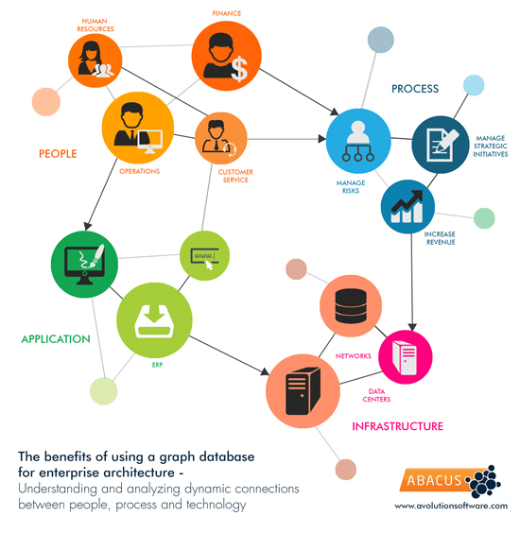
Usecase: Company organization

Slide 46
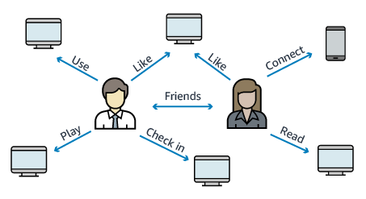
Usecase: Social Networking

Slide 47
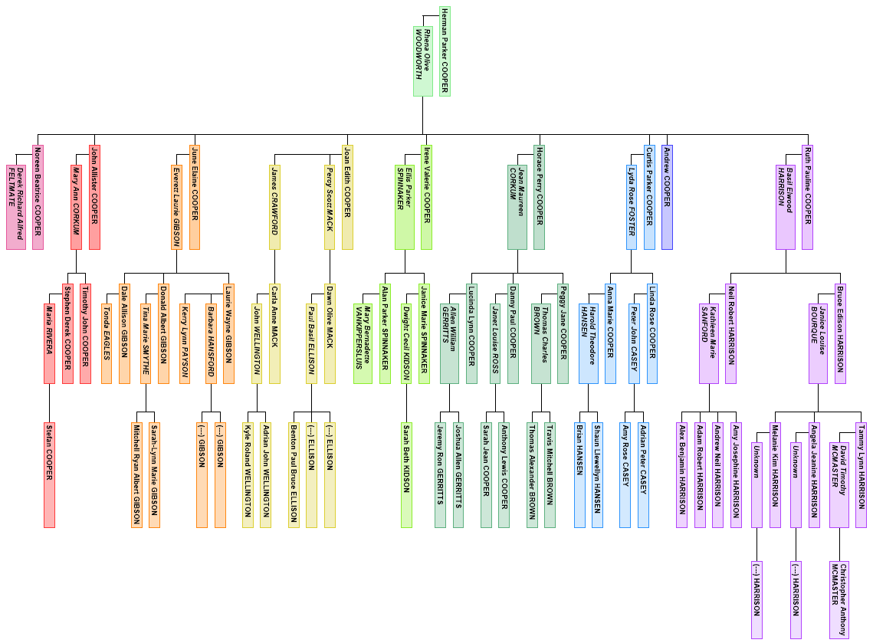
Usecase: Genealogy
Notes:
Thesis on automatic merging of family trees:
https://lup.lub.lu.se/student-papers/search/publication/5154052

Slide 48
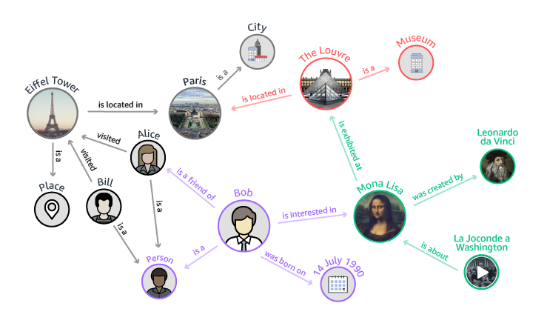
Usecase: Knowledge Graphs

Slide 49
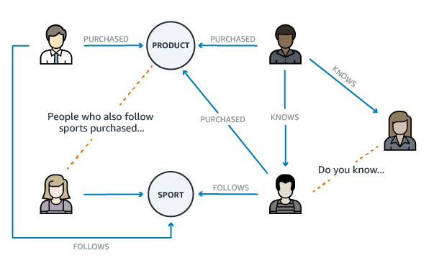
Usecase: Recommendation Engine

Slide 50
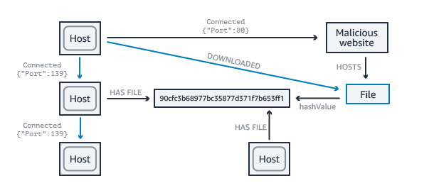
Usecase: Network/IT Operations

Slide 51
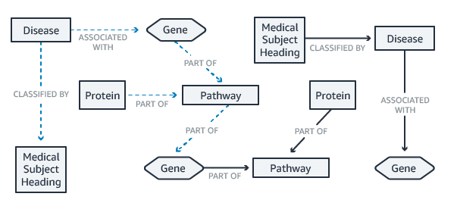
Usecase: Life Sciences

Slide 52
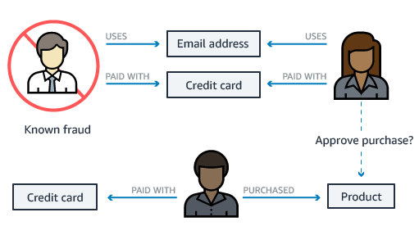
Usecase: Fraud Detection

Slide 53
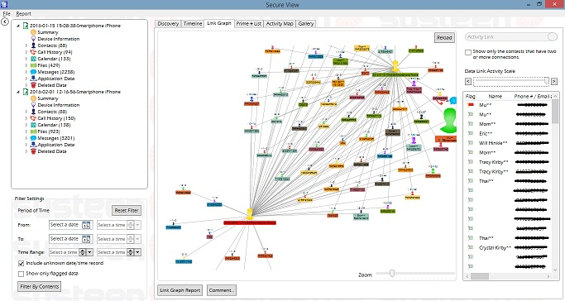
Usecase: Forensic analysis
Notes:
STIX is a standardized format for describing cyber threats
https://oasis-open.github.io/cti-documentation/
It will fit very well in a Neo4j model:
https://github.com/workingDog/StixToNeoDB

Slide 54
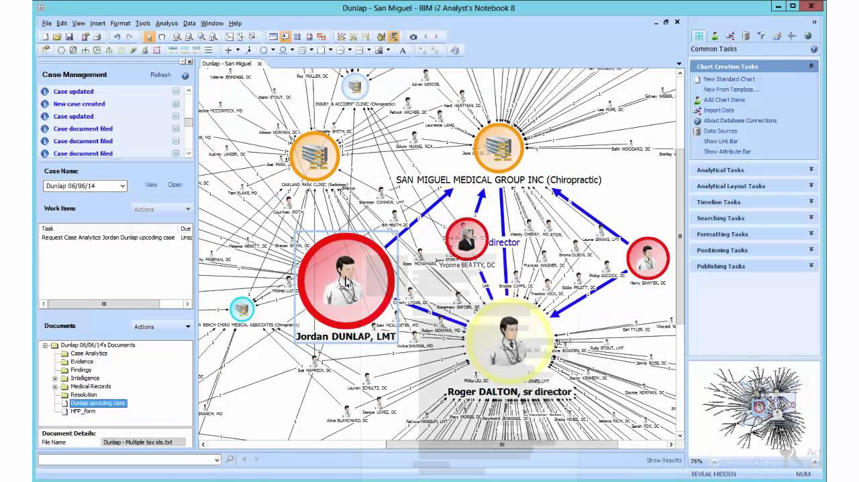
Usecase: Forensic analysis
Notes:
Another interesting example: http://live.yworks.com/yfiles-for-html/2.0/complete/frauddetection/index.html
Other samples:
GDPR
Item relations in car

Slide 55
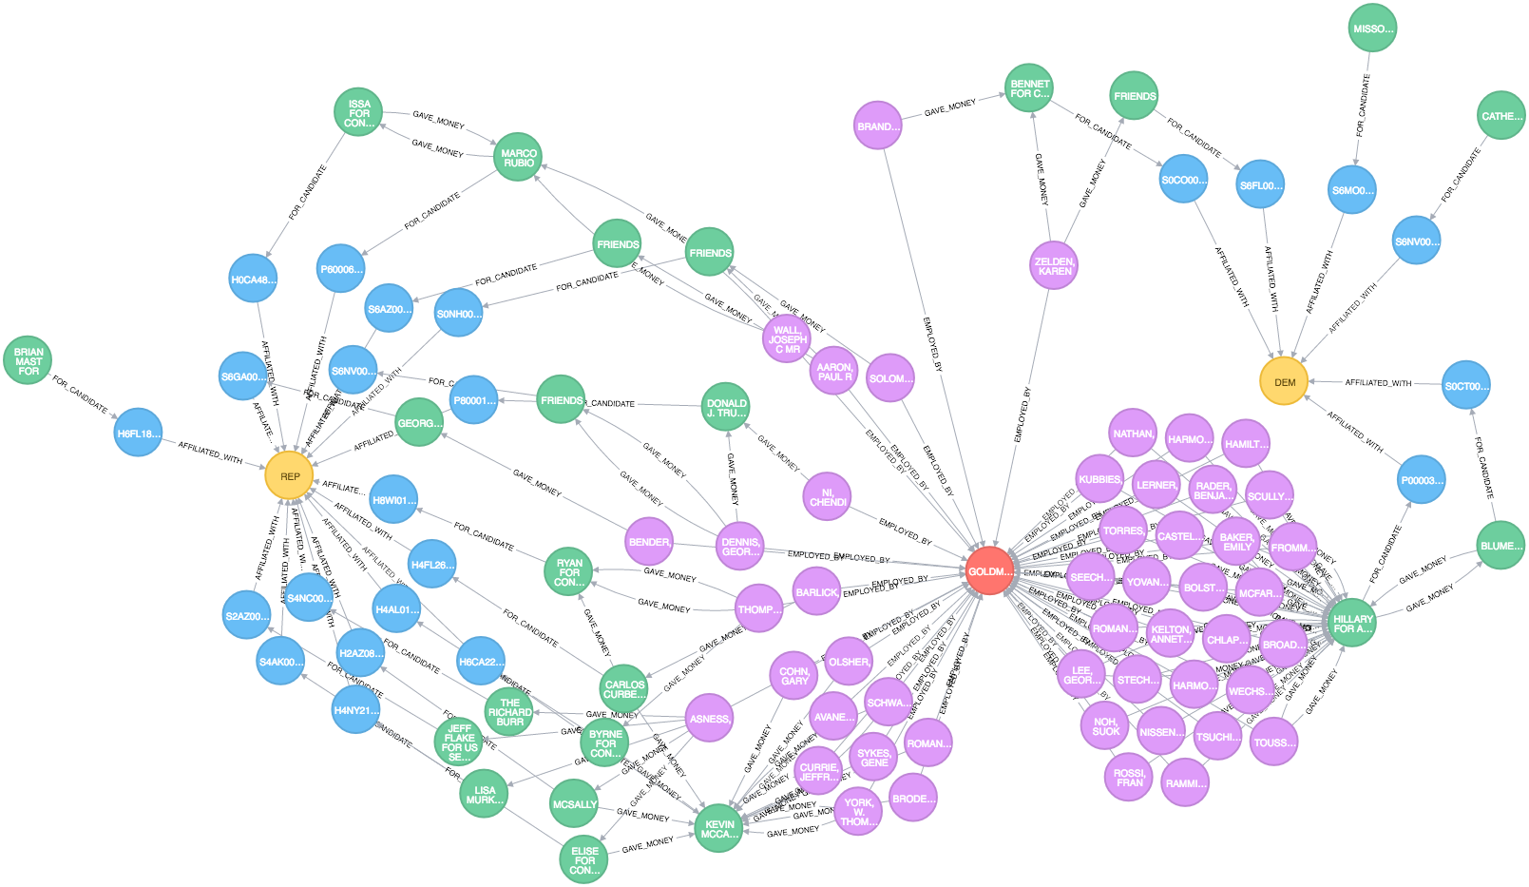
Usecase: Campaign contribution
Notes:
Full explanation found here: https://www.linkedin.com/pulse/graph-database-view-campaign-contributions-zachary-ernst
”.. Each type of entity is represented by its own color: - Red is Goldman-Sachs
- Purple nodes connected to it are employees
- Green circles are committees which accept money on behalf of candidates
- Candidates are colored blue
- Yellow circles are political parties -- the Republican Party is on the left; the Democratic Party is on the right. …”

Slide 56

Closing Challenge
Always pick the best storage for your use case
You should be familiar with SQL + >3 NoSQL variants
Experiment with Graph Database
Start tonight https://github.com/jaklithn
Notes:
The GraphDatabaseDemo repository found at https://github.com/jaklithn holds demo code supporting this presentation.
Applied on two data domains you can see a suggested approach on how to add and search data in Ne04j database.
Hopefully it can serve as a startingpoint for further experimenting.

